Slide 1
COMS 4995
Applied Deep Learning
Final Project Report
Instructor: Josh Gordon
Author: Wen Song(ws2685)
Date: Dec 23, 2022

Slide 2
Agenda
Introduction
Data
Method
Implementation
Extract Patches from Different Levels
Train ResNet50 Model
HeatMap Creation
Conclusion

Slide 3
Introduction
This project aims to build a prediction model for the breast cancer detection using tensorflow. The data source of the image is from CAMELYON16 (https://camelyon16.grand-challenge.org), which contains different zoom levels of breast histopathology slides and their corresponding masks that indicates the position of the cancers.
Methodologies are inspired by the paper “Detecting Cancer Metastases on Gigapixel Pathology Images” (Liu et al. ,2017).
This is a final project for COMS 4995: Applied Deep Learning taught by Joshua Gordon at Columbia University in Fall 2022.

Slide 4
Data
Source: CAMELYON16
Tool:
Tensorflow, a free and open-source software library for machine learning and artificial intelligence
OpenSlide, a C library that provides a simple interface to read whole-slide images

Slide 5
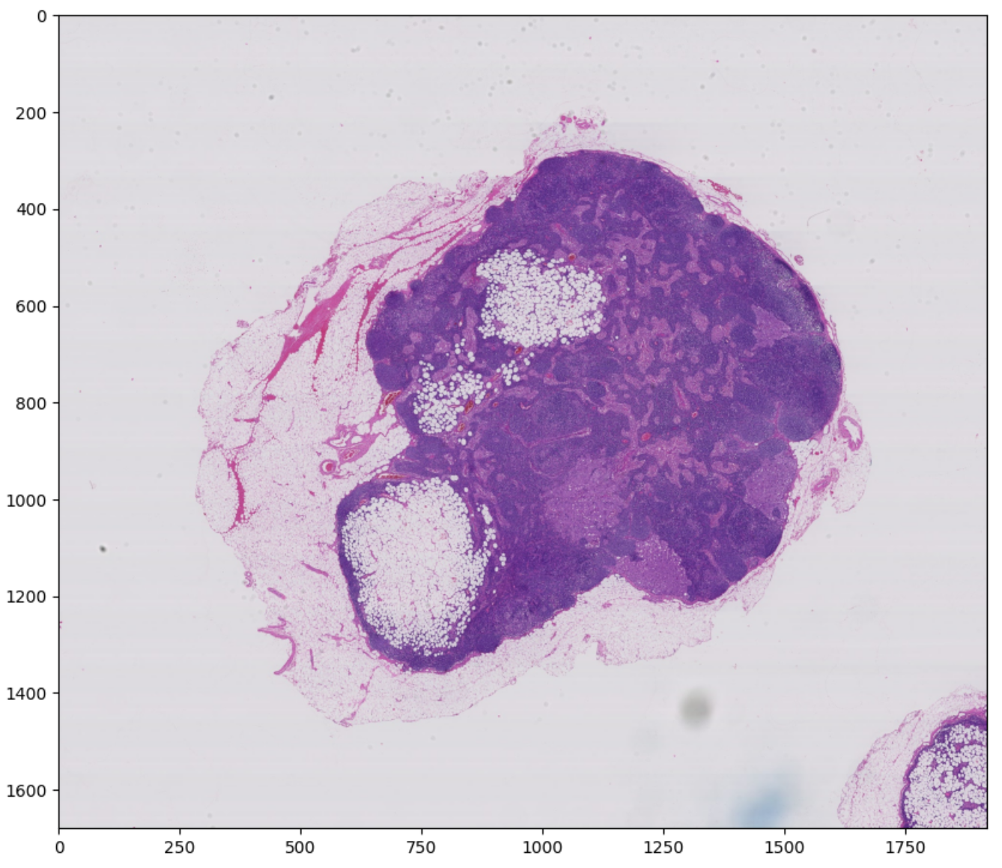
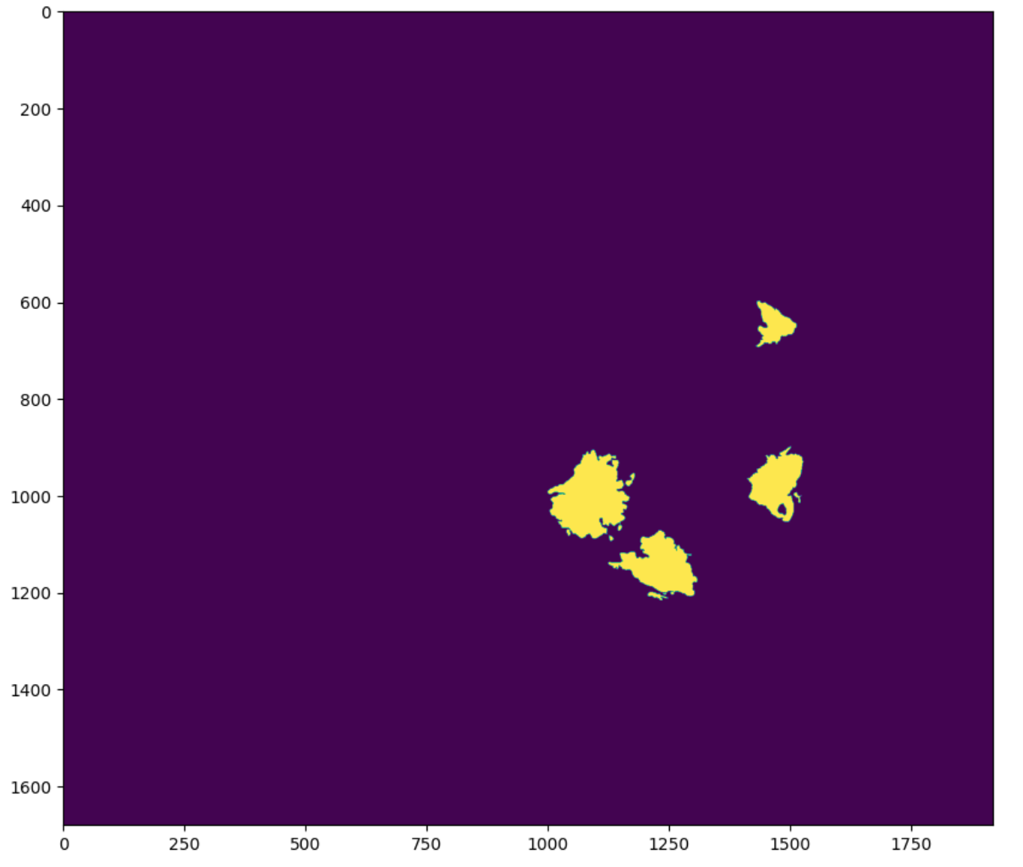
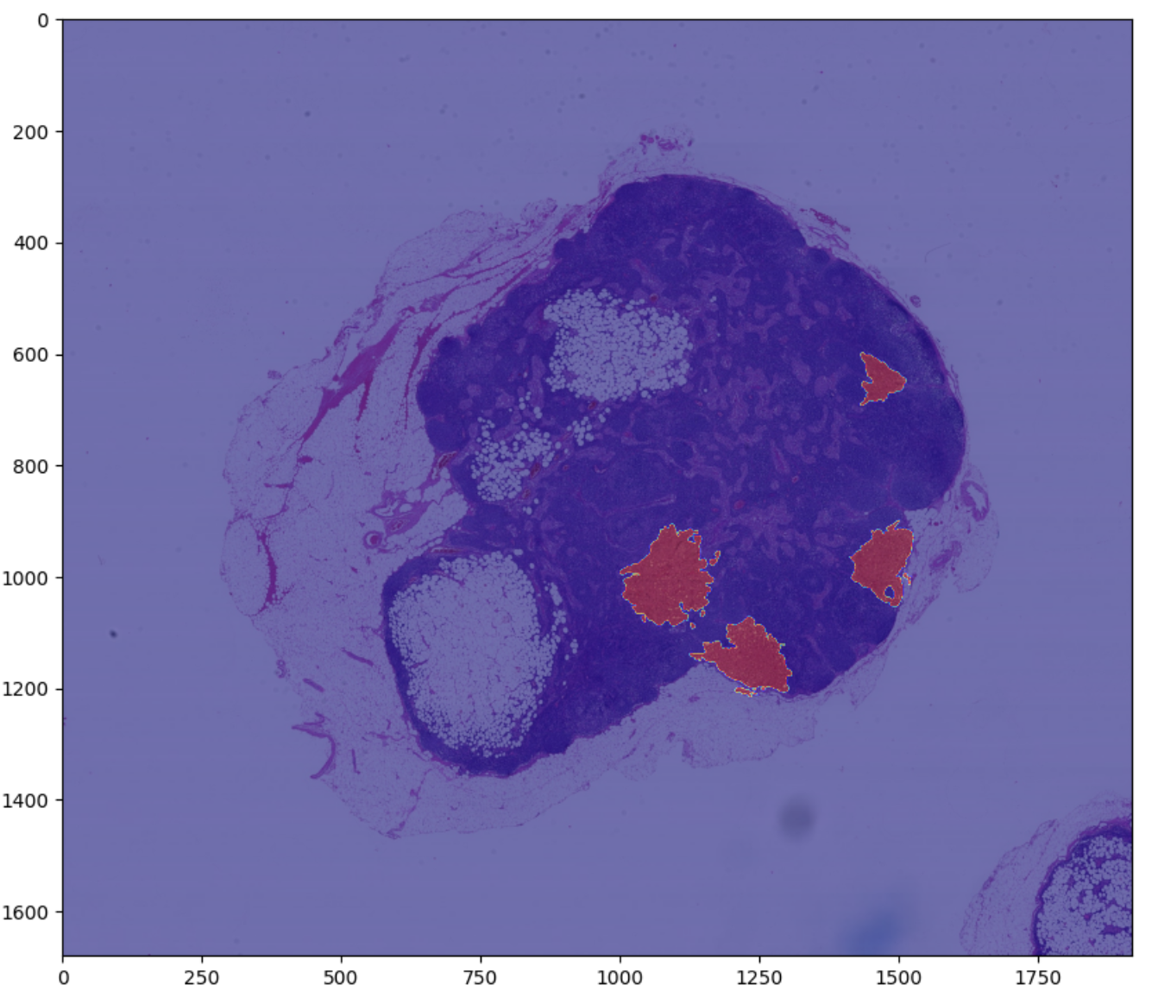
Data Example
Tissue
Tissue Mask
Overlay Tissue and its mask

Slide 6
Goal
Given a collection of training data:
Train a model to predict the cancerous regions for slides
Create a heatmap indicating the predicted cancerous regions of a biopsy image

Slide 7
Method
Overview: Use Sliding Window method to extracting patches with size (75, 75) at different zoom levels, train a model on the extracted patches, predict the label for patches on test slides, finally generate a heatmap for the prediction
Step 1: Extract Patches on Level 5
Step 2: Train a ResNet Model on Patches from Level 5 and Show Prediction
Step 3: Extract Patches on Level 4
Step 4: Concatenate Patches from Level 4 and Level 5
Step 5: Retrain the ResNet Model and Show Prediction
Architecture: ResNet50 Model
Loss: Binary Cross Entropy Loss
Patch Size: (75, 75)
Zoom Level used: 4, 5

Slide 8
Training and Test Slides
Training Slides:
001, 002, 005, 012, 016, 019, 023, 031, 035, 057, 059, 064, 075, 078, 081, 084, 094, 096, 101
Test Slides:
091, 110

Slide 9
Implementation
Extract Patches from Level 4 and Level 5
Use size 75 * 75 as patch size for prediction
Ignore the regions with less than 20% tissue to reduce the influence of noise
Deal with imbalanced data:
Randomly shuffle cancerous patches and normal patches so that they are not in the same order as they were in the extraction
Use data augmentation to rotate the extracted cancerous patches by different degrees
Patches Extraction

Slide 10
Implementation
Use ResNet50 Model
Load the ImageNet pretrained weights without the top layers
Add Dense layers
Use RMSprop as optimizer with learning_rate = 0.0001
Train Model - Transfer Learning

Slide 11
Implementation
Use sliding window method on test slide to extract patches
Apply the prediction model created previously on the patches
If current patch is predicted as 1, then change the color of current patch to be red
HeatMap Creation

Slide 12
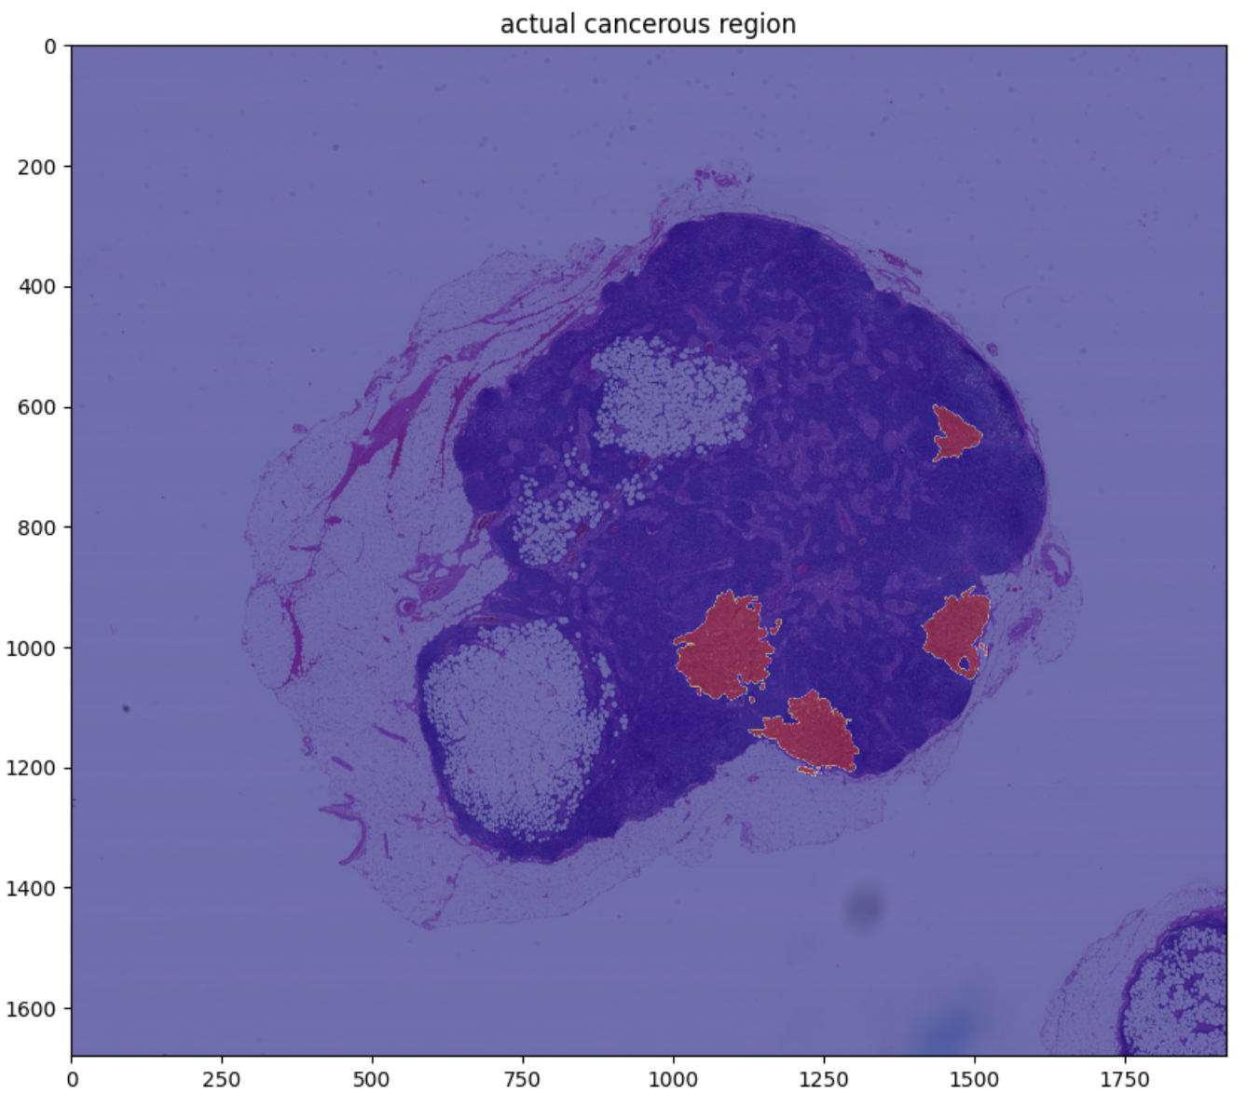
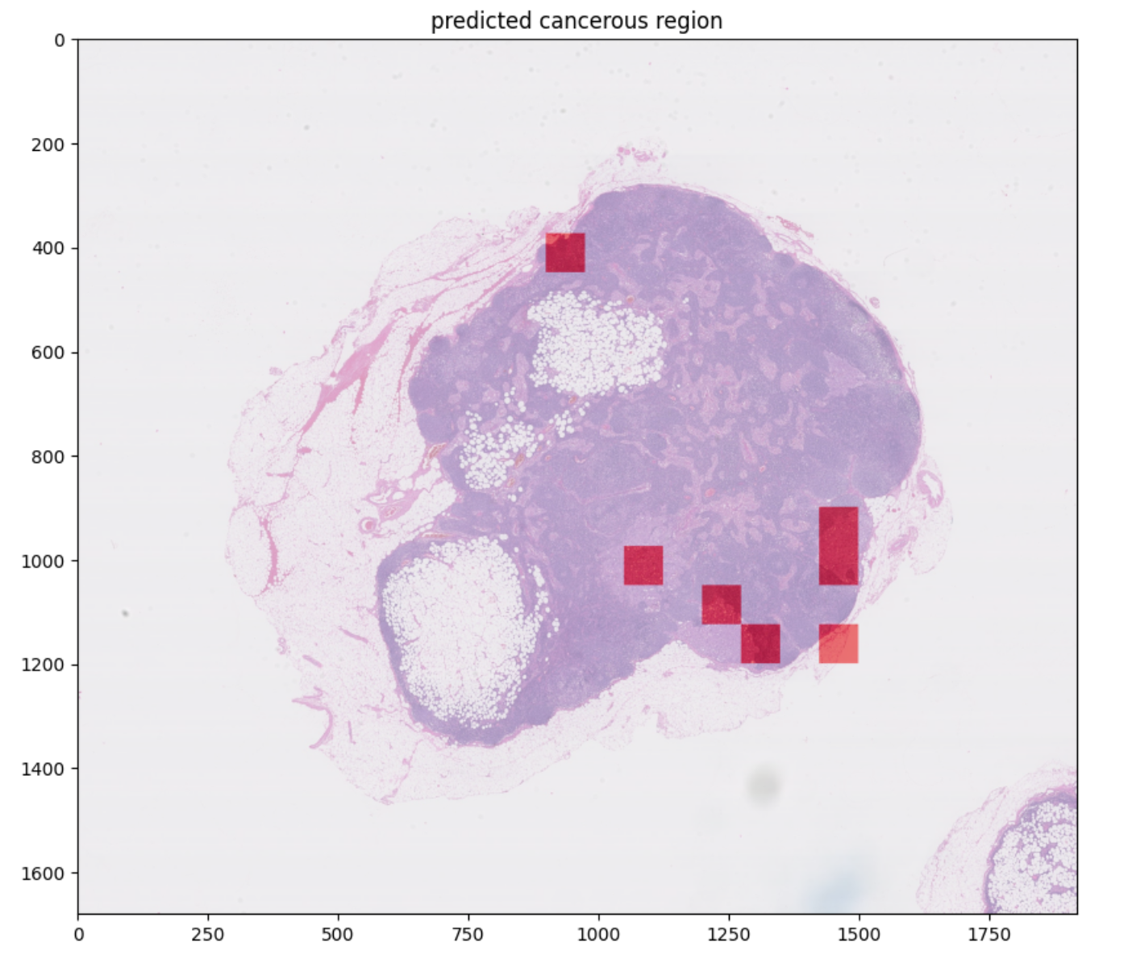
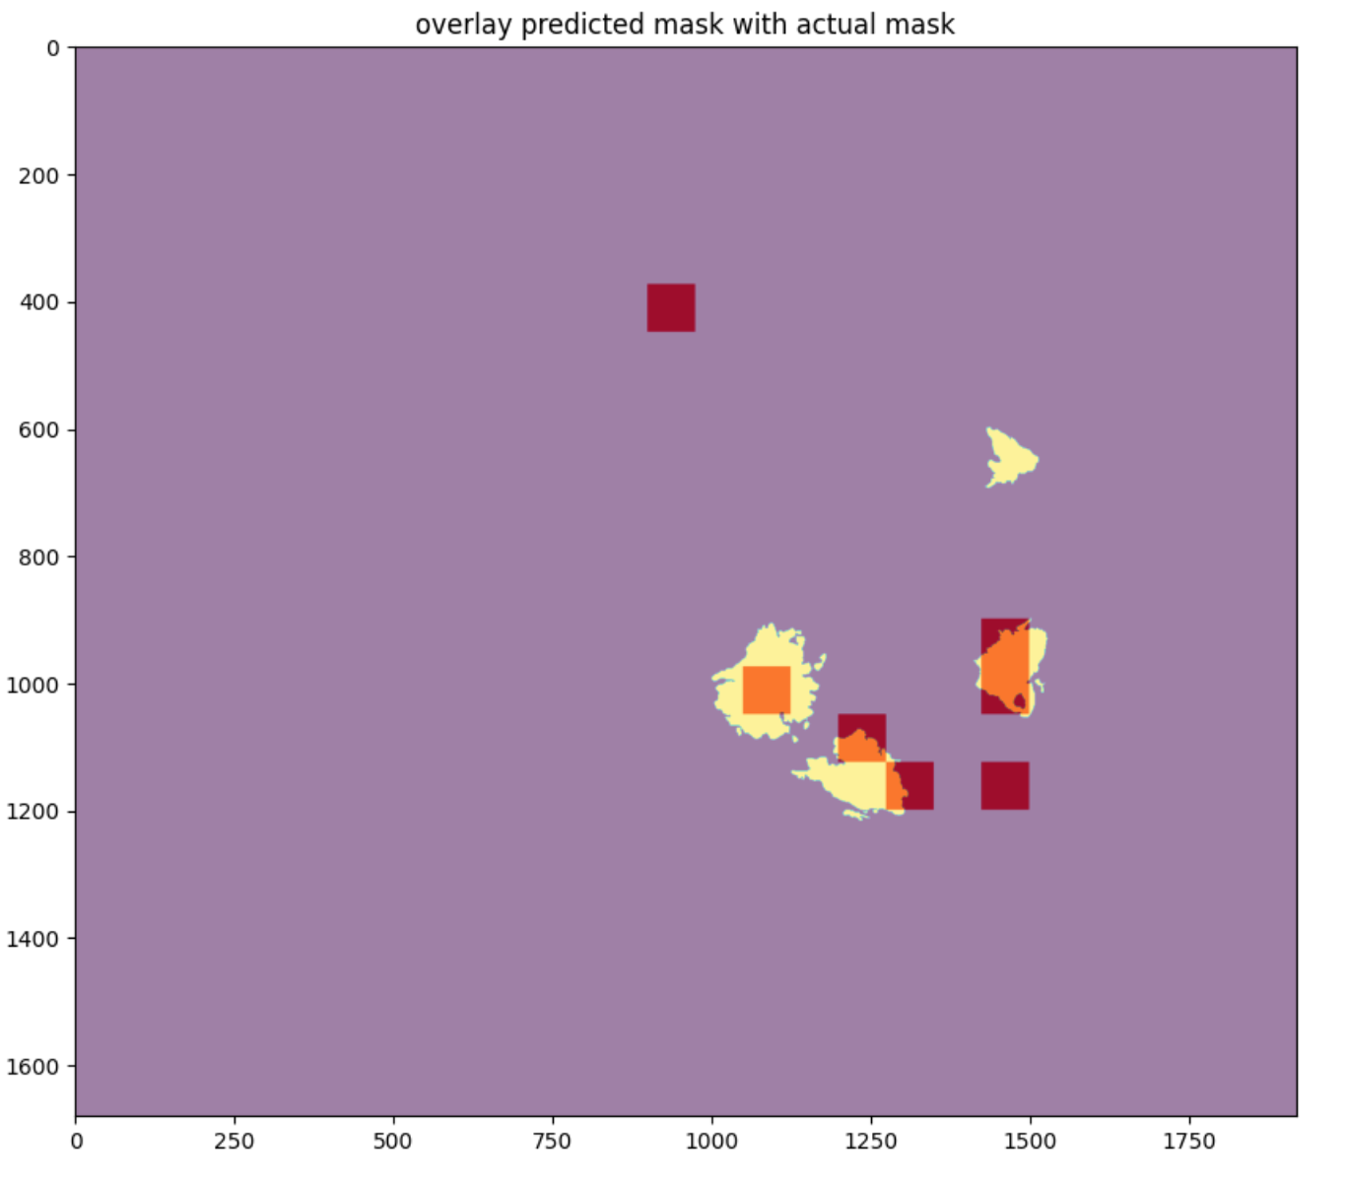
Visualization
Prediction Based on Model with Single Level (Level 5) as Input
Prediction on Tumor 91

Slide 13
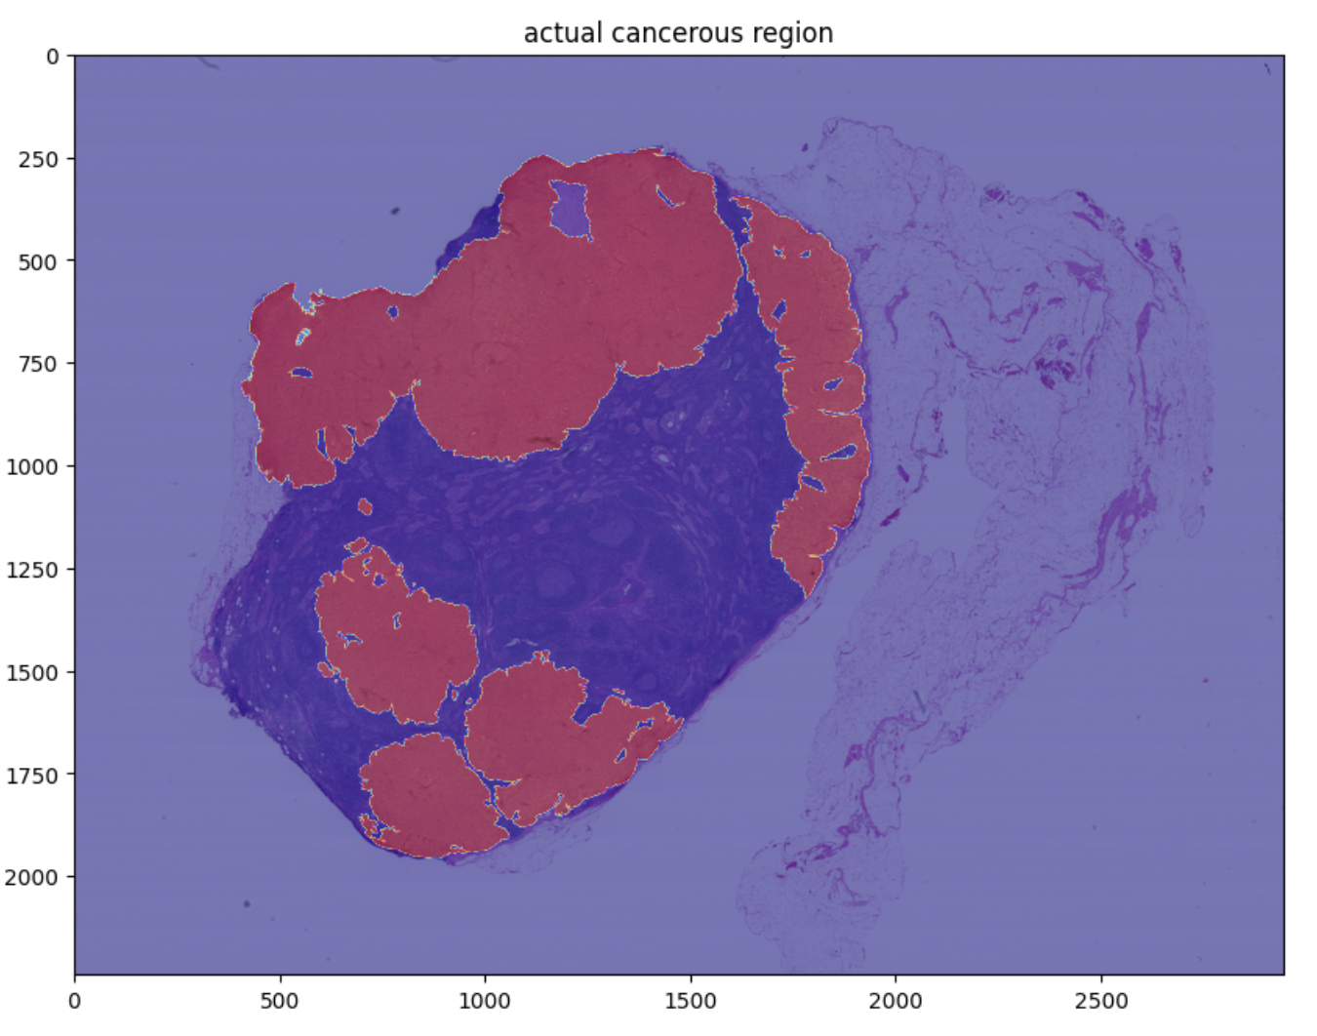
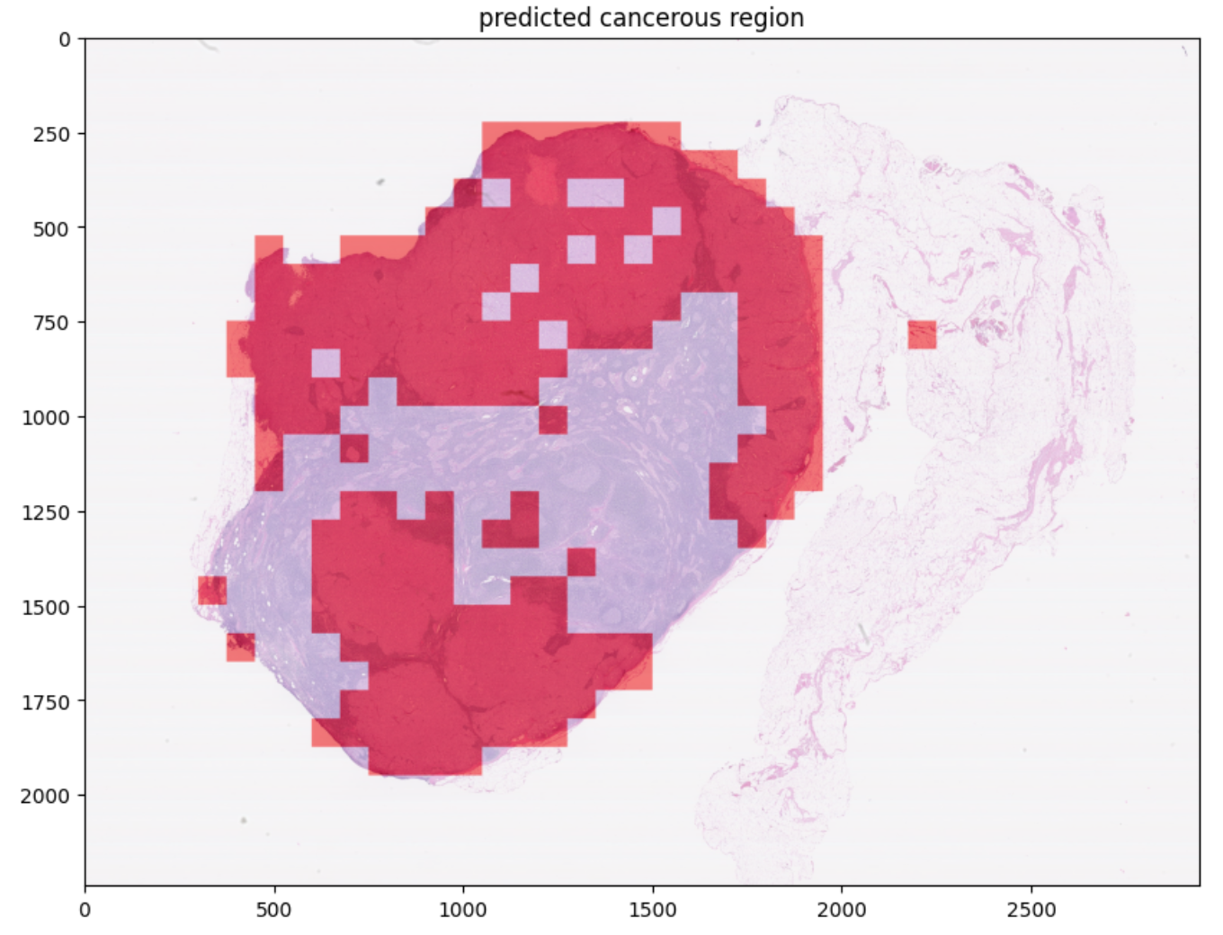
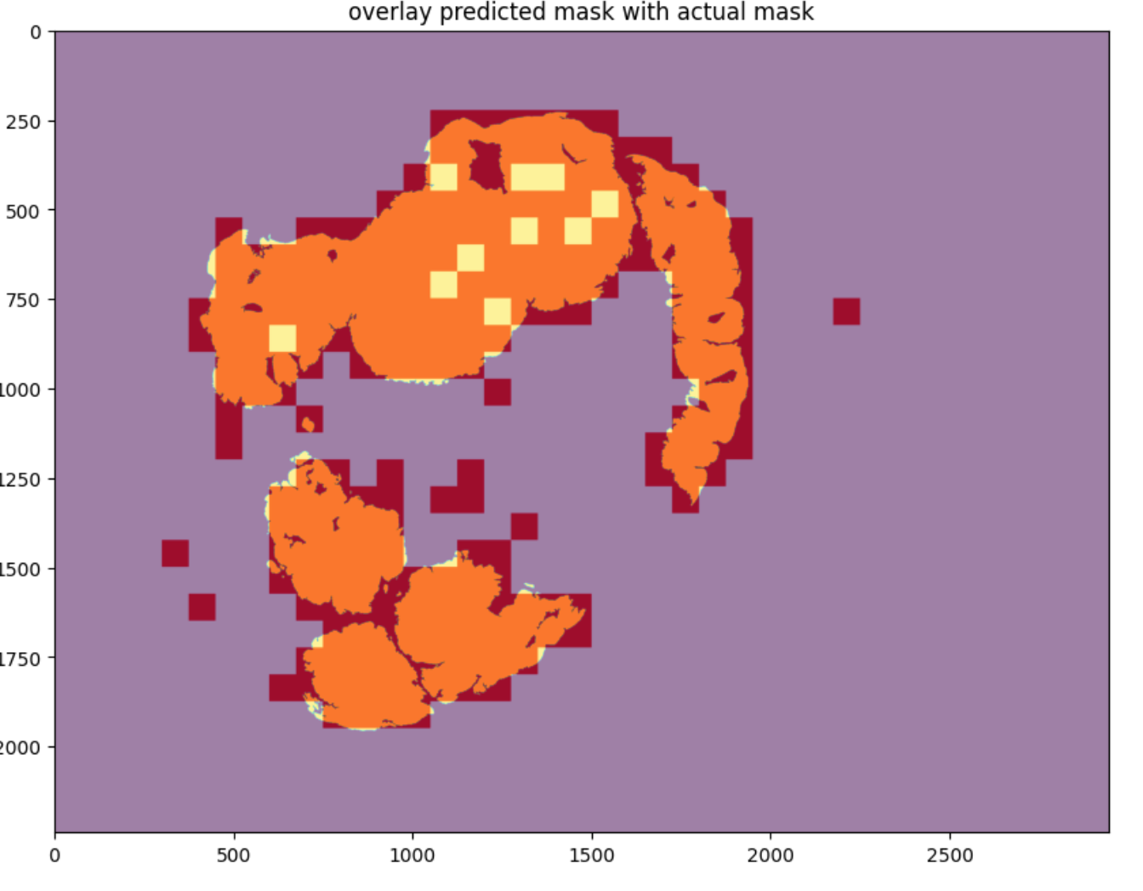
Visualization
Prediction Based on Model with Single Level (Level 5) as Input
Prediction on Tumor 110

Slide 14
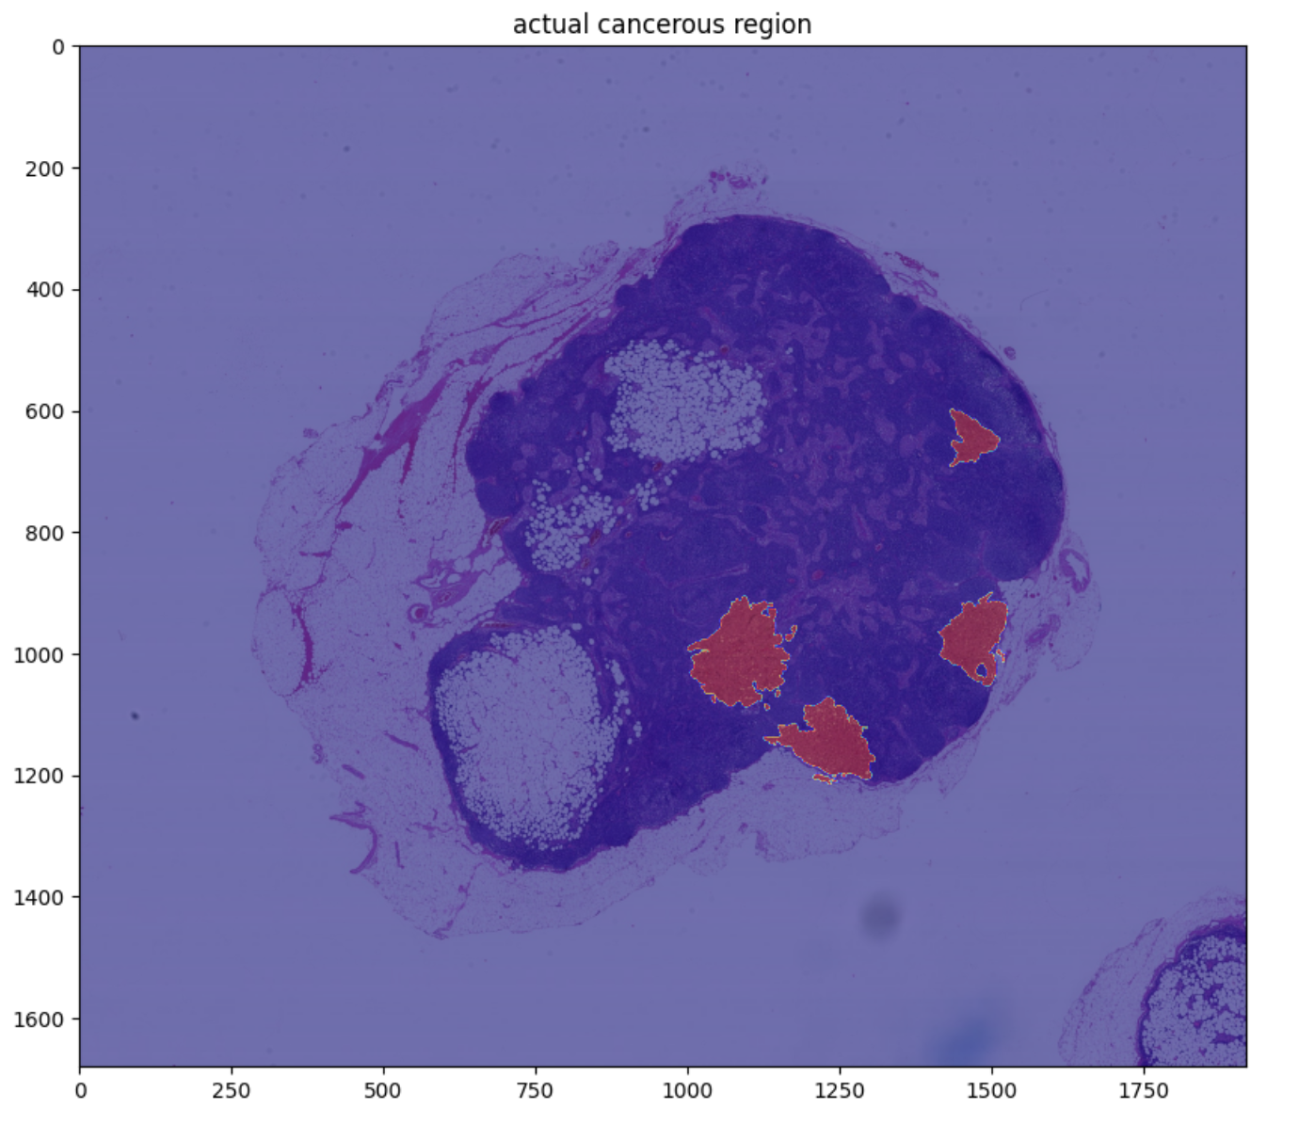
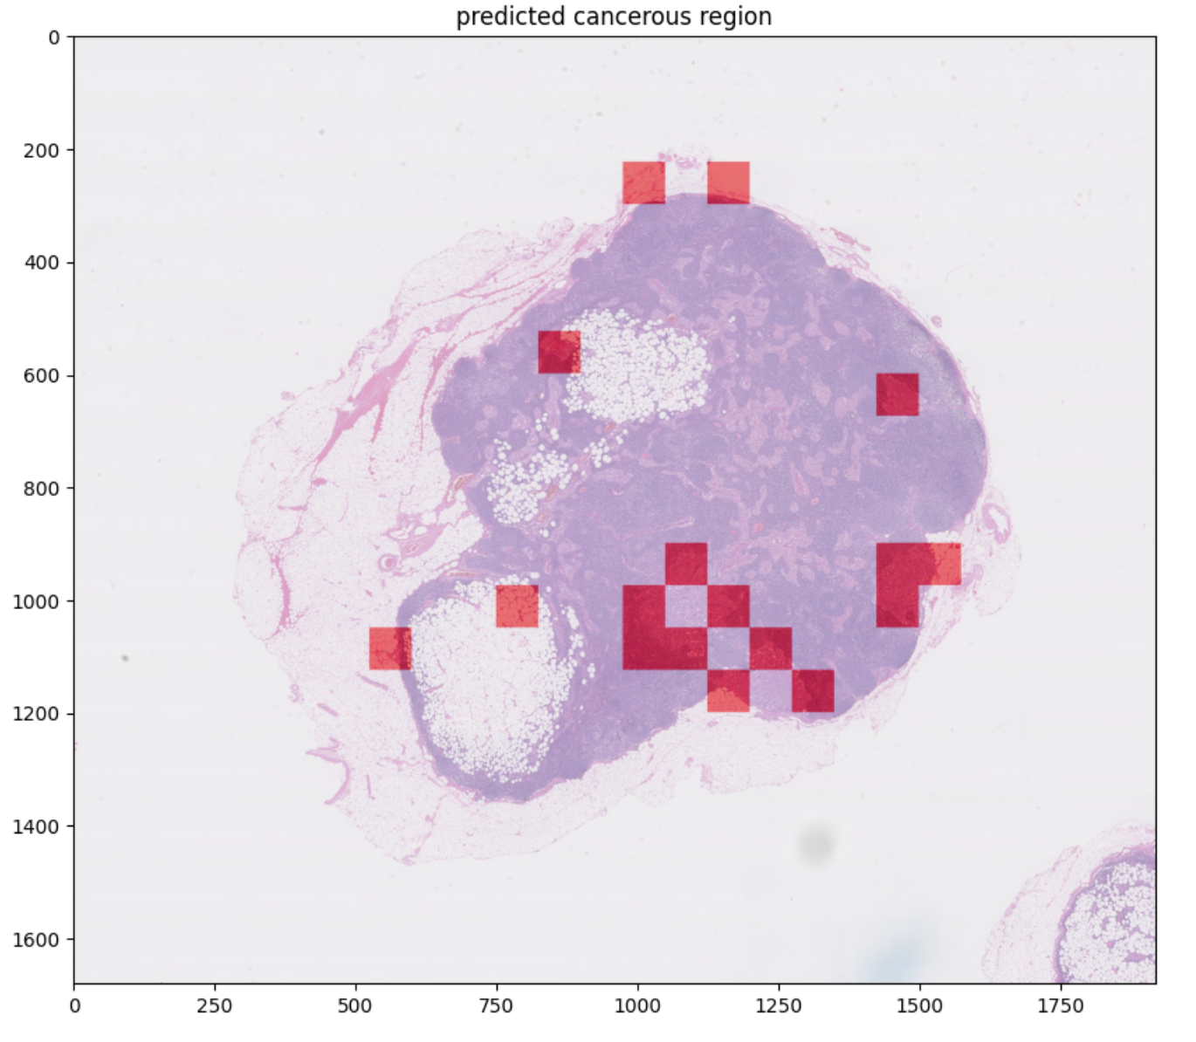
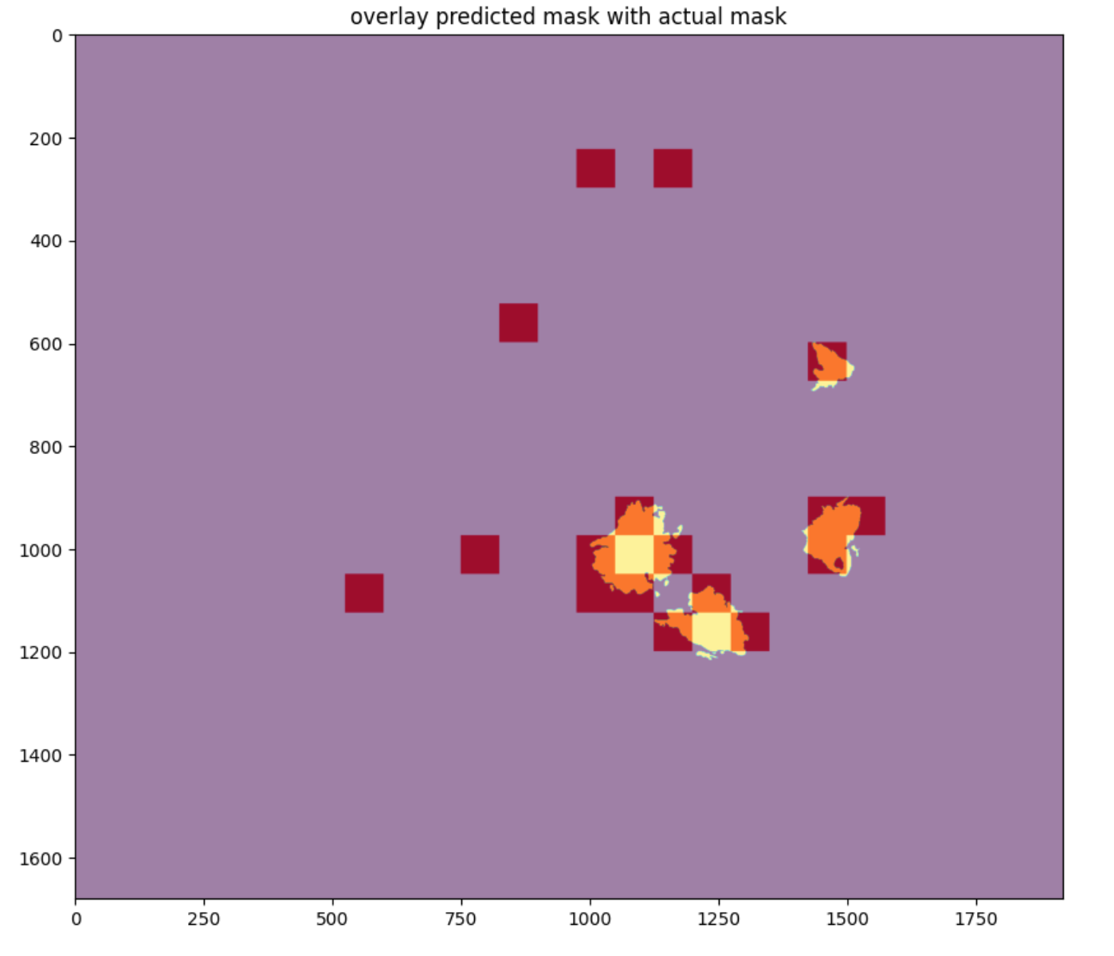
Visualization
Prediction Based on Model with Multiple Levels (Level 4 and Level 5) as Input
Prediction on Tumor 91

Slide 15
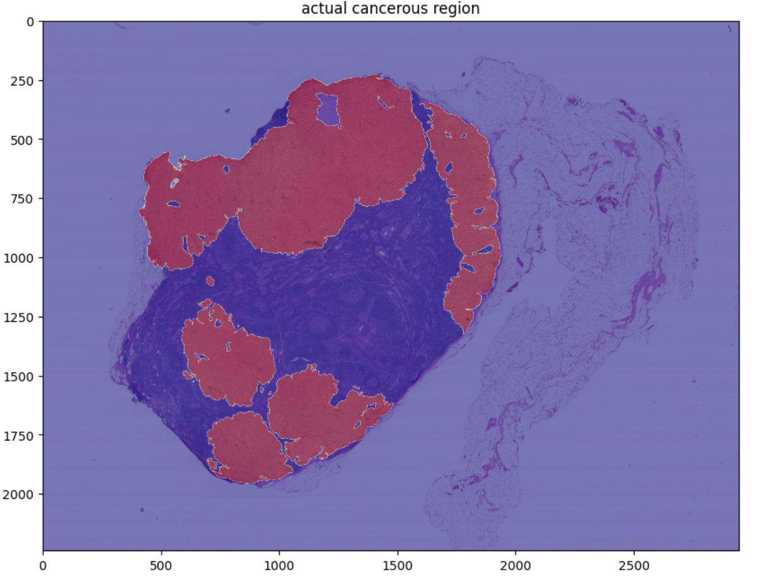
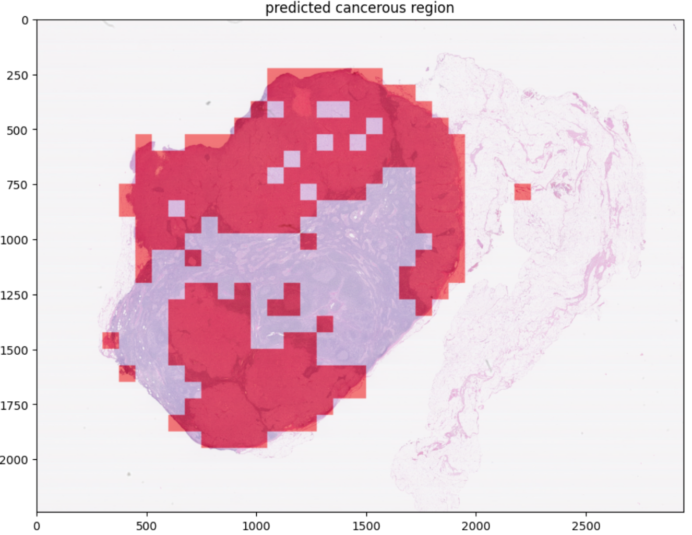
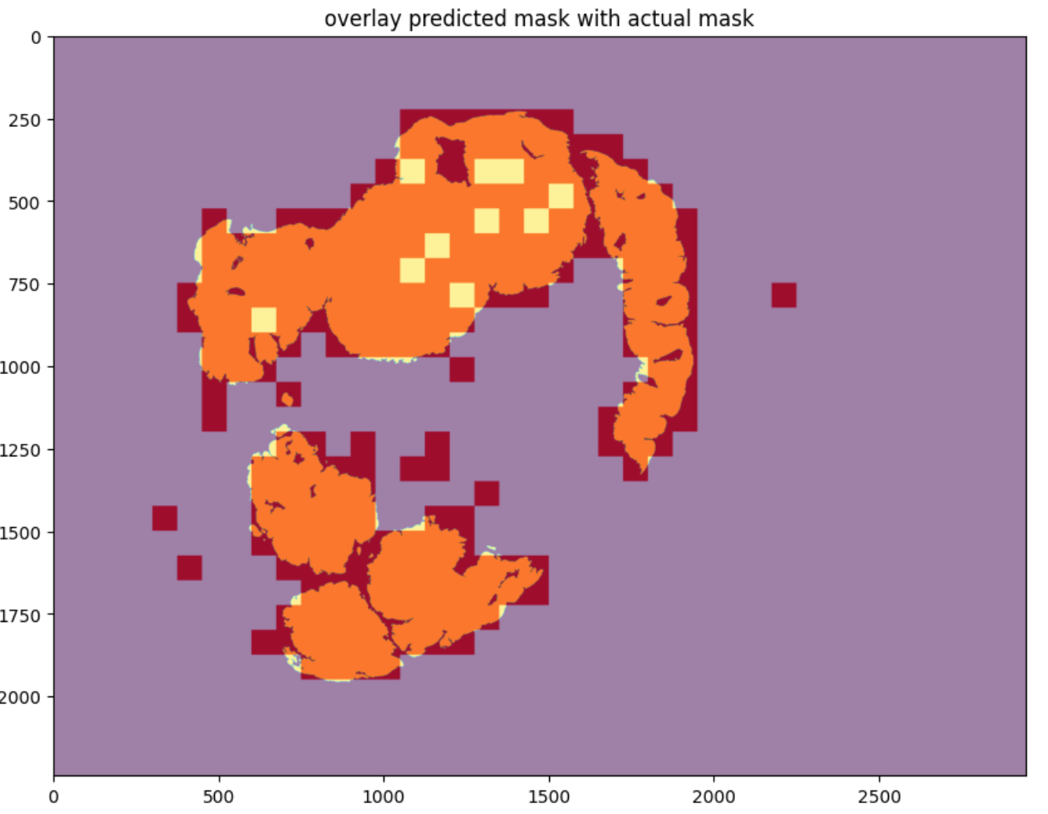
Visualization
Prediction Based on Model with Multiple Levels (Level 4 and Level 5) as Input
Prediction on Tumor 110

Slide 16
Conclusion
With higher magnification patches fed into the model, the loss is decreased and the accuracy is improved

Slide 17
Next Steps
Extract Patches from More Different Levels
Use Multi-Scale Model
Improve Computation Power

